Slide 1
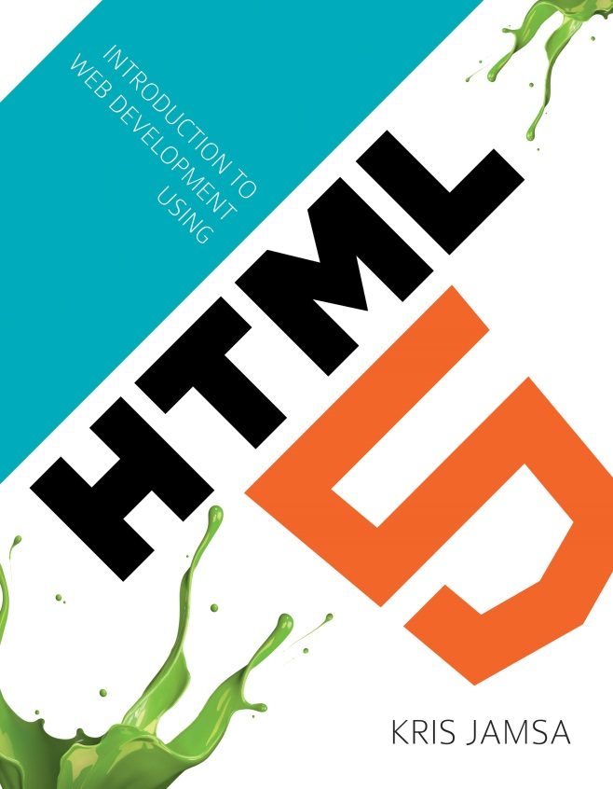
Chapter 23
CSS Transformations and Rotations

Slide 2
Learning Objectives
How to use the transform property rotate function to rotate an HTML element on a page
How to use the transform property translate function to move an HTML element on a page
How to use the transform property scale function to increase or decrease the size of an HTML element on a page
How to use the transform property skew function to skew an HTML element on a page along the object’s x or y axis

Slide 3
Css transform property
The CSS transform property provides several functions you can use with CSS styles to translate or move, rotate, skew, or scale an HTML element. Depending on your browser, the name of the transform property may differ:
-moz-transform: -ms-transform: -o-transform: -webkit-transform: transform:

Slide 4

Rotating an image
<!DOCTYPE html> <html> <head> <style type="text/css"> .right { -moz-transform: rotate(345deg); -ms-transform: rotate(345deg); -o-transform: rotate(345deg); -webkit-transform: rotate(345deg); transform: rotate(345deg); } .left { -moz-transform: rotate(15deg); -ms-transform: rotate(15deg); -o-transform: rotate(15deg); -webkit-transform: rotate(15deg); transform: rotate(15deg); } </style> </head> <body> <img class="left" width="300" height="200" src="http://www.websitedevelopmentbook.com/Chapter23/dog.jpg" /> <img class="right" width="300" height="200" src="http://www.websitedevelopmentbook.com/Chapter23/wine.jpg" /> <br/> <img class="left" width="300" height="200" src="http://www.websitedevelopmentbook.com/Chapter23/cat.jpg" /> <img class="right" width="300" height="200" src="http://www.websitedevelopmentbook.com/Chapter23/cigar.jpg" /> </body> </html>

Slide 5
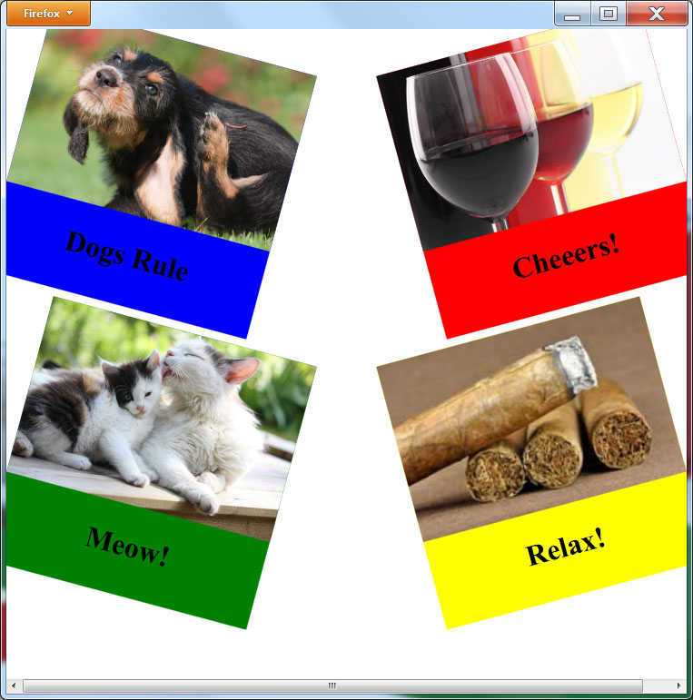
Rotating divs (text and images)
<!DOCTYPE html> <html> <head> <style type="text/css"> .right { -moz-transform: rotate(345deg); -ms-transform: rotate(345deg); -o-transform: rotate(345deg); -webkit-transform: rotate(345deg); transform: rotate(345deg); float:right; } .left { -moz-transform: rotate(15deg); -ms-transform: rotate(15deg); -o-transform: rotate(15deg); -webkit-transform: rotate(15deg); transform: rotate(15deg); float:left; } h1 { text-align:center; } </style> </head> <body> <div class="left" style="width:300px; height:300px; background-color: blue;"> <img width="300" height="200" src="http://www.websitedevelopmentbook.com/Chapter23/dog.jpg" /> <h1>Dogs Rule</h1> </div> <div class="right" style="width:300px; height:300px; background-color: red;"> <img width="300" height="200" src="http://www.websitedevelopmentbook.com/Chapter23/wine.jpg" /> <h1>Cheeers!</h1> </div> <div style="clear:both;"></div> <br/> <div class="left" style="width:300px; height:300px; background-color: green;"> <img width="300" height="200" src="http://www.websitedevelopmentbook.com/Chapter23/cat.jpg" /> <h1>Meow!</h1> </div> <div class="right" style="width:300px; height:300px; background-color: yellow;"> <img width="300" height="200" src="http://www.websitedevelopmentbook.com/Chapter23/cigar.jpg" /> <h1>Relax!</h1> <div> </body> </html>

Slide 6
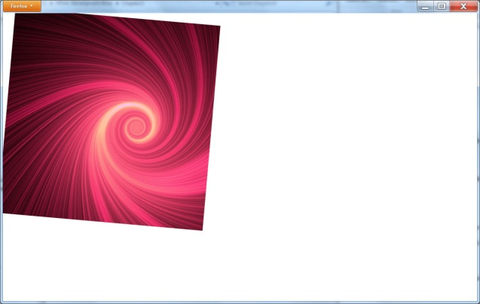
Spinning an object with css and javascript
<!DOCTYPE html> <html> <head> <script> var i = 0;
function SpinImage() { document.getElementById("body").innerHTML = '<img ' + 'style="-moz-transform: rotate(' + i + 'deg); ' + '-ms-transform: rotate(' + i + 'deg); ' + '-o-transform: rotate(' + i + 'deg); ' + '-webkit-transform: rotate(' + i + 'deg); ' + 'transform: rotate(' + i + 'deg); "' + 'src="http://www.websitedevelopmentbook.com/chapter23/spiral.jpg">'; i = i + 1; } </script> </head> <body id="body" onload="setInterval(function() { SpinImage(); }, 25)"> </body> </html>

Slide 7
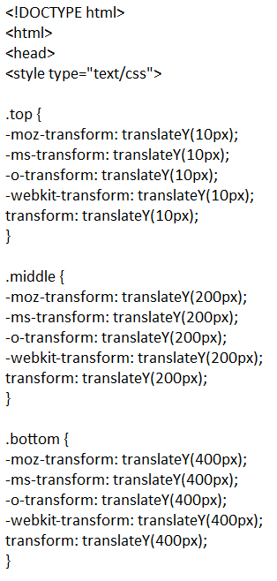
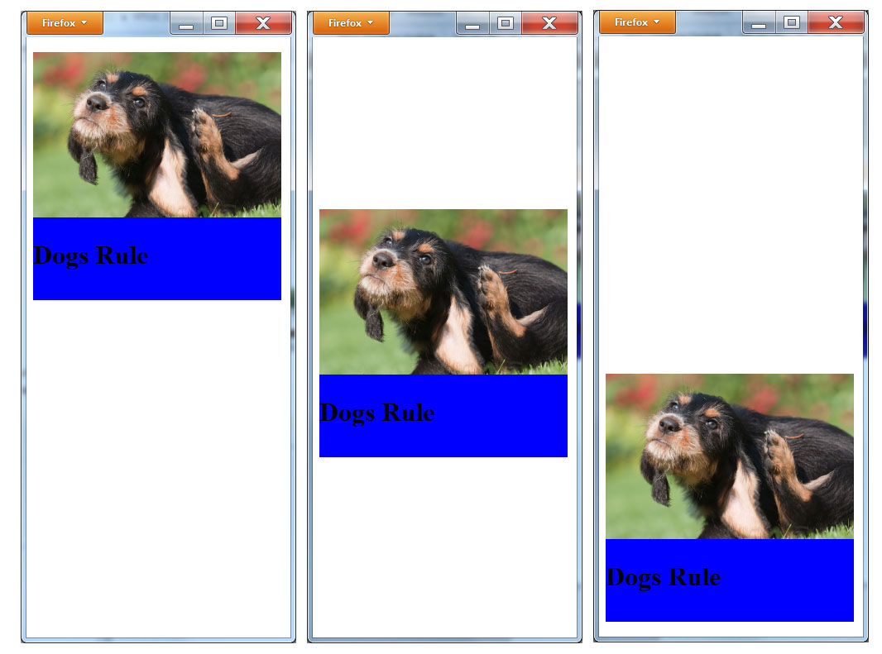
Moving and translating a div

Slide 8
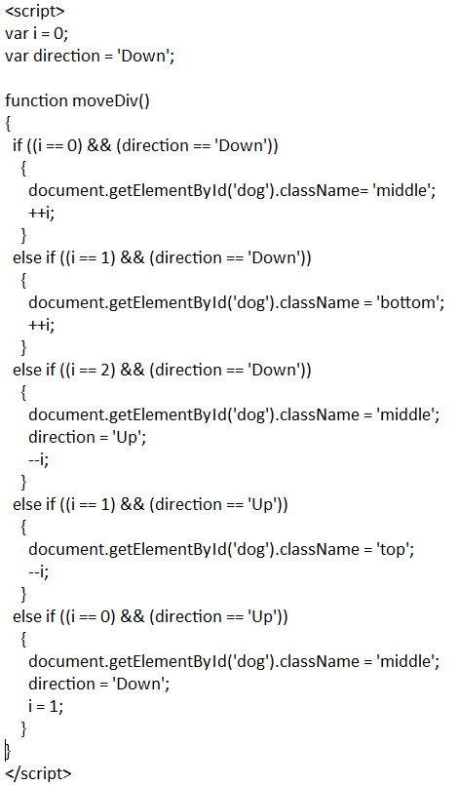
continued

Slide 9
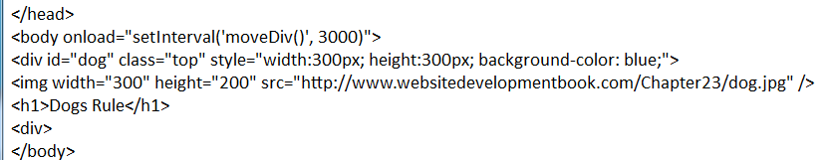
continued

Slide 10
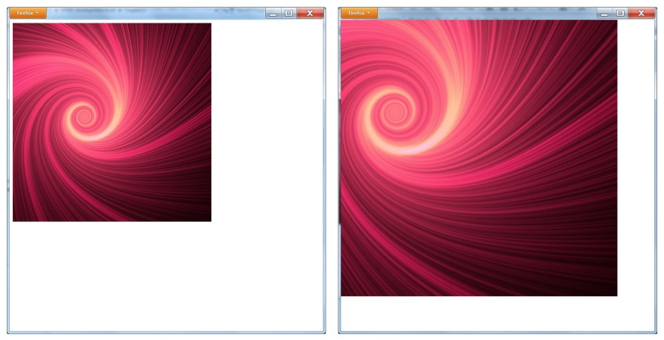
Scaling an object
<!DOCTYPE html> <html> <head> <script> vari = 1.0; var direction = 'Grow'; function GrowAndShrink() { document.getElementById("body").innerHTML = '<img ' + 'style="-moz-transform: scale(' + i + ', ' + i + '); ' + '-ms-transform: scale(' + i + ', ' + i + '); ' + '-o-transform: scale(' + i + ', ' + i + '); ' + '-webkit-transform: scale(' + i + ', ' + i + '); ' + 'transform: scale(' + i + ', ' + i + '); "' + 'src="http://www.websitedevelopmentbook.com/chapter23/spiral.jpg">'; if (direction == 'Grow') i = i + 0.25; else i = i - 0.25; if (i == 1.0) direction = 'Grow'; else if (i == 2.0) direction = 'Shrink'; } </script> </head> <body id="body" onload="setInterval(function() { GrowAndShrink(); }, 500)"> </body> </html>

Slide 11
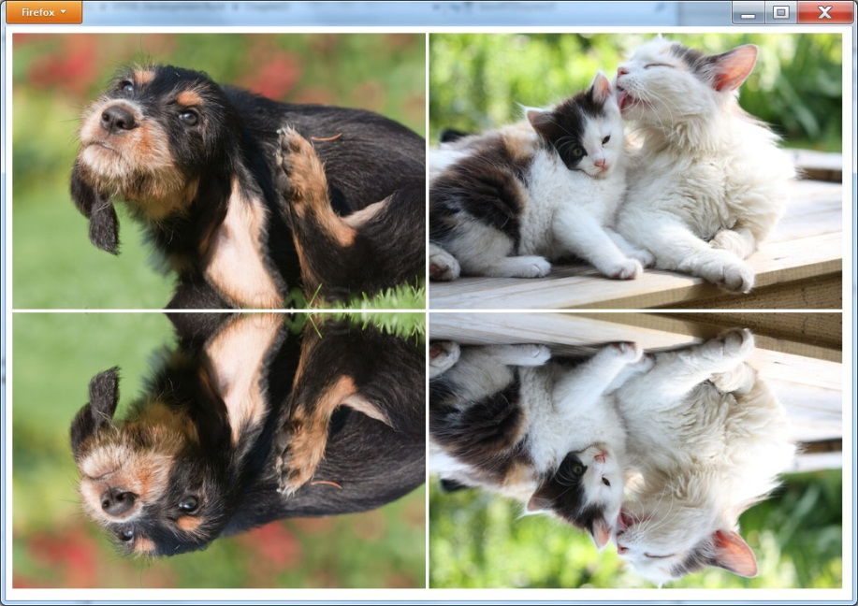
Flipping an object
<!DOCTYPE html> <html> <head> <style> .flip { -moz-transform: scaleY(-1); -ms-transform: scaleY(-1); -o-transform: scaleY(-1); -webkit-transform: scaleY(-1); transform: scaleY(-1); } </style> </head> <body> <imgsrc="http://www.websitedevelopmentbook.com/chapter23/dog.jpg"> <img src="http://www.websitedevelopmentbook.com/chapter23/cat.jpg"><br/> <img class="flip" src="http://www.websitedevelopmentbook.com/chapter23/dog.jpg"> <img class="flip" src="http://www.websitedevelopmentbook.com/chapter23/cat.jpg"><br/> </body> </html>

Slide 12
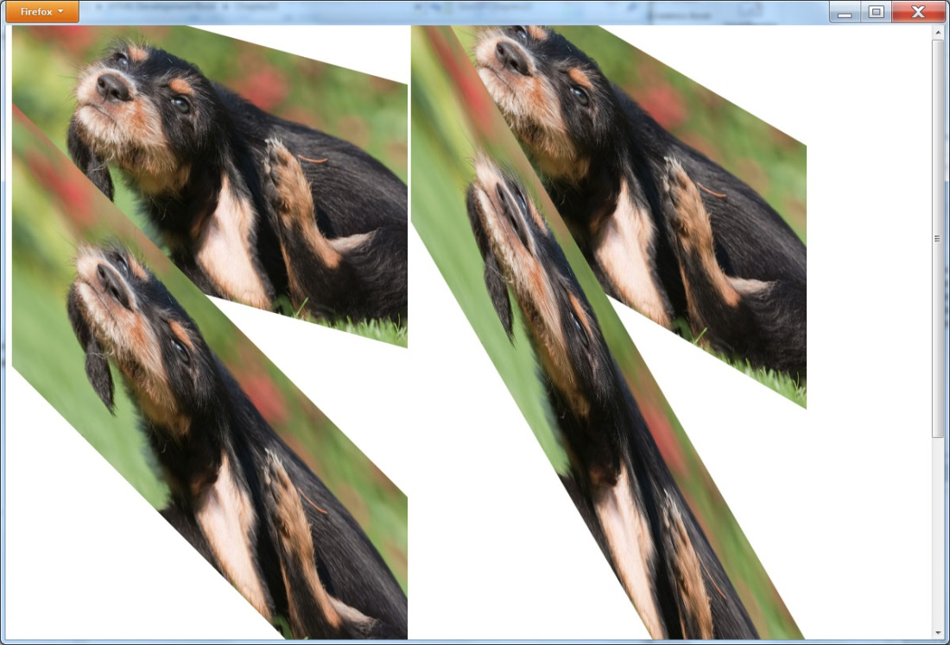
Skewing an object
<!DOCTYPE html> <html> <head> <style> .skew15 { -moz-transform: skewY(15deg); -ms-transform: skewY(15deg); -o-transform: skewY(15deg); -webkit-transform: skewY(15deg); transform: skewY(15deg); } .skew30 { -moz-transform: skewY(30deg); -ms-transform: skewY(30deg); -o-transform: skewY(30deg); -webkit-transform: skewY(30deg); transform: skewY(30deg); }
.skew45 { -moz-transform: skewY(45deg); -ms-transform: skewY(45deg); -o-transform: skewY(45deg); -webkit-transform: skewY(45deg); transform: skewY(45deg); } .skew60 { -moz-transform: skewY(60deg); -ms-transform: skewY(60deg); -o-transform: skewY(60deg); -webkit-transform: skewY(60deg); transform: skewY(60deg); } </style> </head> <body> <img class="skew15" src="http://www.websitedevelopmentbook.com/chapter23/dog.jpg"> <img class="skew30" src="http://www.websitedevelopmentbook.com/chapter23/dog.jpg"><br/> <img class="skew45" src="http://www.websitedevelopmentbook.com/chapter23/dog.jpg"> <img class="skew60" src="http://www.websitedevelopmentbook.com/chapter23/dog.jpg"><br/> </body> </html>

Slide 13
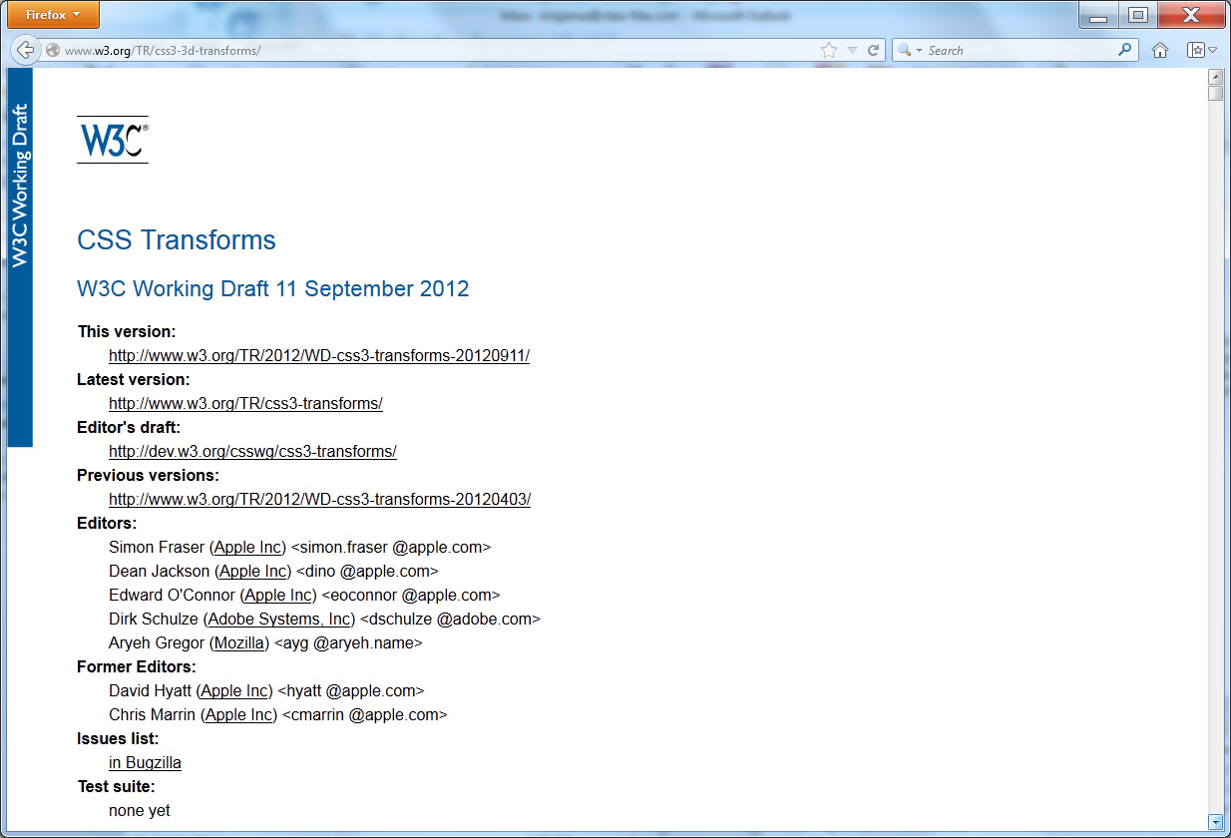
Real word: 3D transforms

Slide 14
summary
Using JavaScript, CSS, and JQuery, you have learned a variety of ways to manipulate HTML elements on a page.
In this chapter, you examine ways to perform text and image translations rotations using CSS as well as scaling and skewing operations.

